Slide 1
Power BI: What’s New? What’s Next?
Rich Deken
Bennett Adelson
11 July 2017

Slide 2
About Me
Practice Director @ Bennett Adelson
16 years @ MSFT
1 year @ Qlik
4+ years @ BA
rdeken@bennettadelson.com
Twitter @BIatBA

Slide 3
About Bennett Adelson

Slide 4
About Bennett Adelson

Slide 5
Next Month Azure Cognitive Services: Artificial Brains in Your App! August 9, 2017

Slide 6
Demos, Demos, Demos

Slide 7
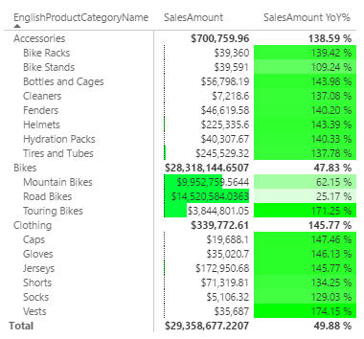
Table and Matrix Drill and Conditional Formatting

Slide 8
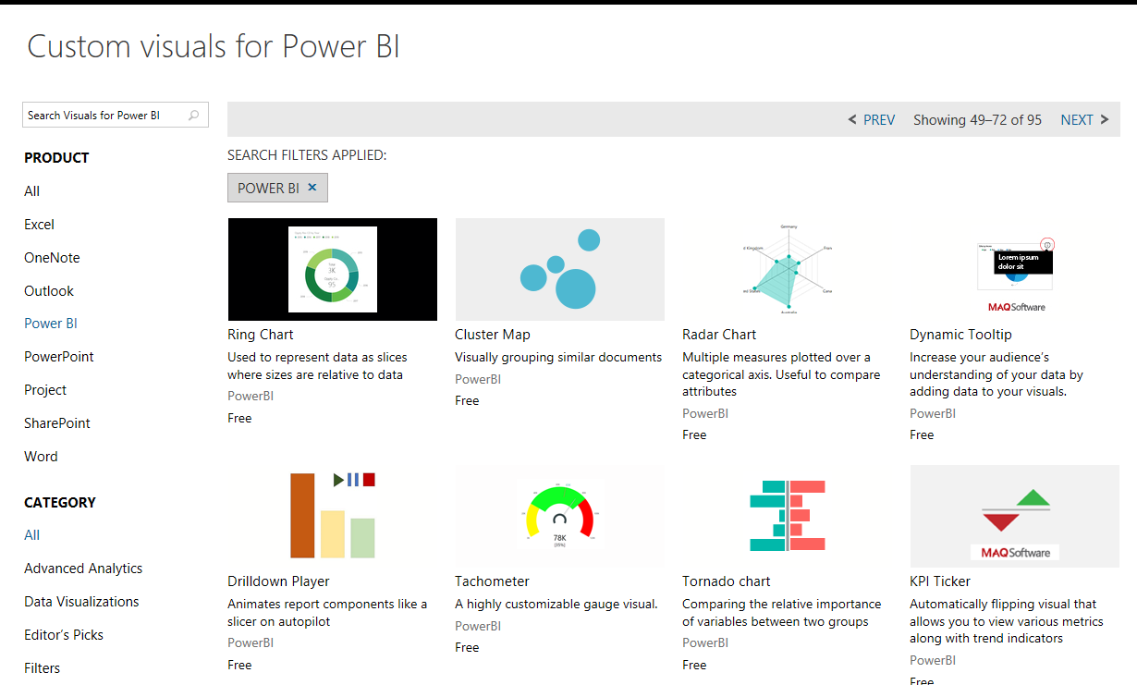
New Visuals Gallery

Slide 9
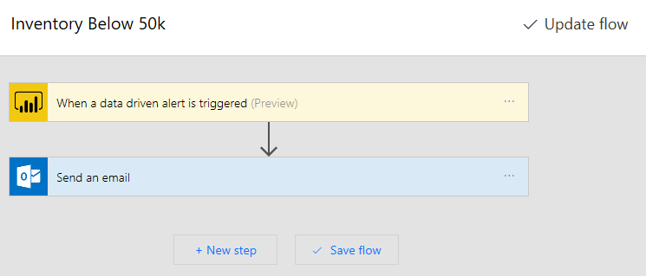
Alerting and Integration

Slide 10
Quick Measures

Slide 11
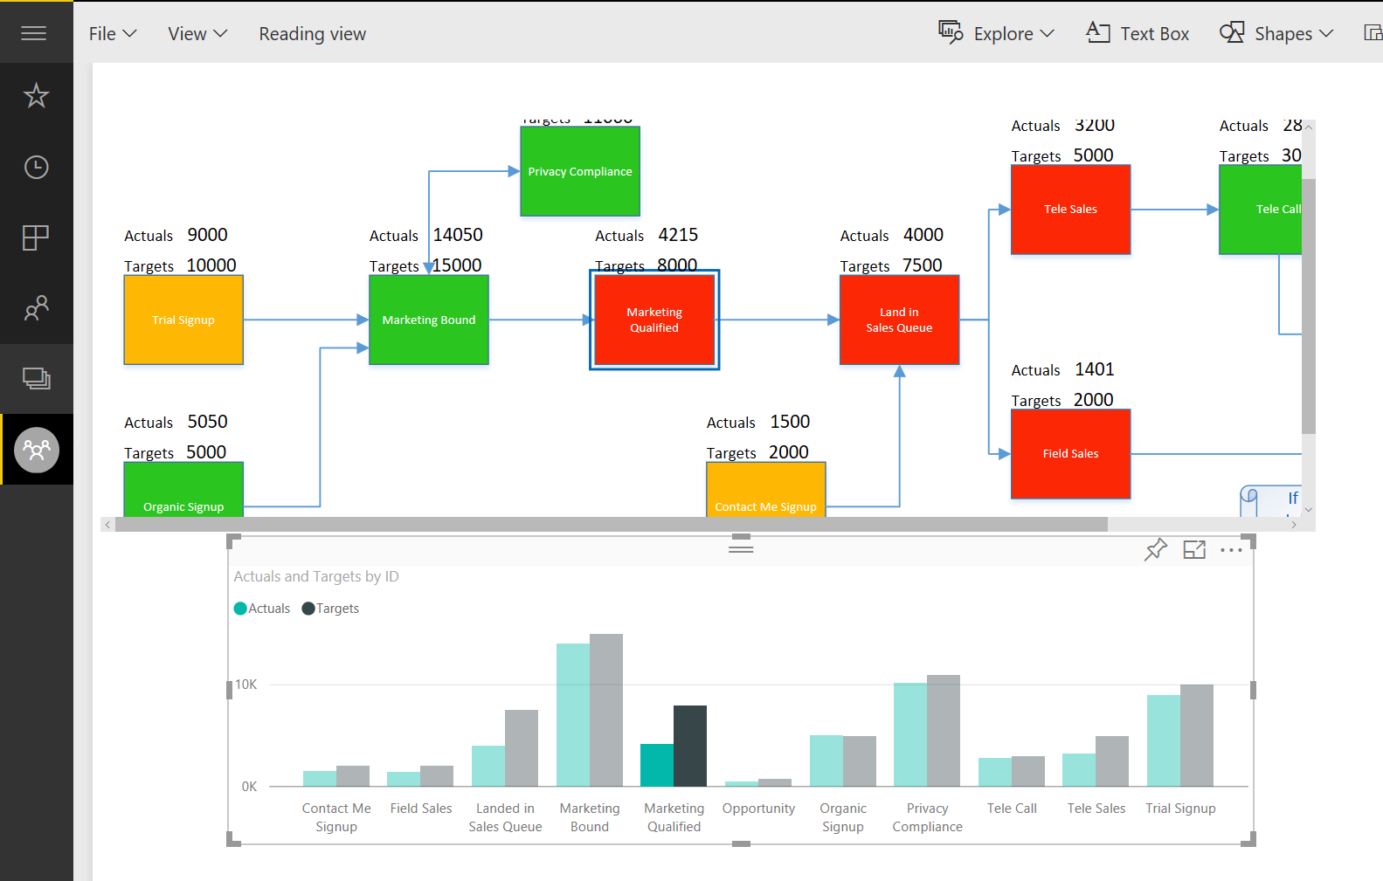
Custom Visio Visuals

Slide 12
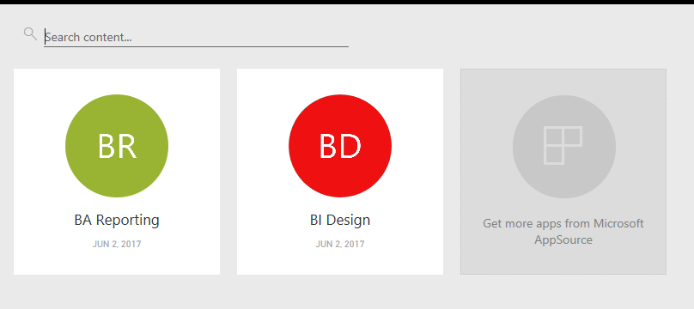
Power BI Apps

Slide 13
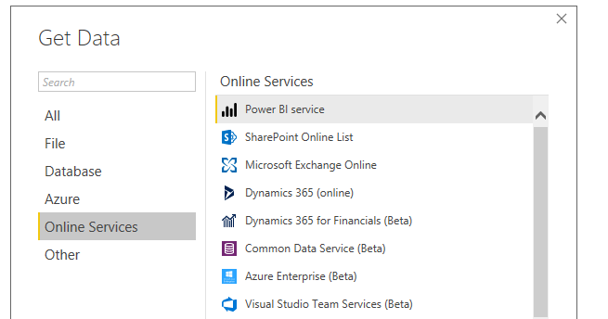
Reuse Power BI Models

Slide 14
Power BI Premium

Slide 15
What’s coming
What-if analysis
Bookmarking and Storytelling
Play
Show and hide
Timeline Storyteller
“Explain the increase” automatically using Machine Learning
Improved visualizations
Eg, Waterfall chart with “Top N”
Improved Theming
Responsive visualizations for improved mobile
Drill To
Q&A in iPhone app
“Conversational natural language”
Custom visuals exporting to PowerPoint
Deeper integration with R
Closer PowerApps integration
Embedded PowerApp control in a report
Enabling write-back scenarios

Slide 16
